Slide 1


Microsoft Secret Management What, When, Why and How
Mike Kanakos

Slide 2
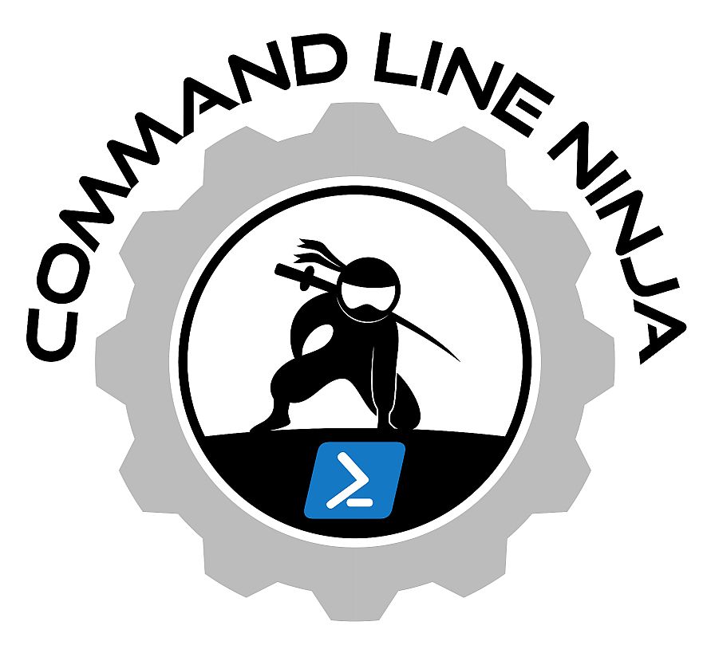

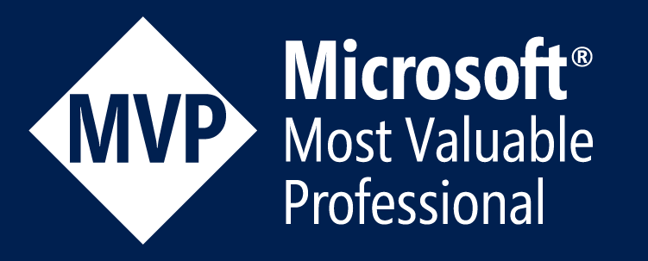

> whoami
Find me online: https://linktr.ee/mikekanakos

Slide 3
Today’s Agenda
SecretManagement Module Overview
What, When, Why, How…
What are Partner Modules
Everyday Secrets Usage
Install & Config
General Use
Azure KeyVault
Basic overview

Slide 4

Secret Management: Why?
Uber Breach - September 2022
An attacker gained access to Uber's internal systems by exploiting a vulnerability related to an admin's credentials left exposed.
The attacker reportedly used stolen credentials from an employee's Slack account, which were accessible in plain sight.
Exposed Data:
Employee Credentials & Company Proprietary Source Code

Slide 5




How the SecretMgmt module works
1Password Module
U: DAdmin P: ******
U: EAdmin P: ******
U: Mike P: ******
Microsoft SecretStore Module
Microsoft SecretManagement Module
AZKeyvault Module
Console

Slide 6
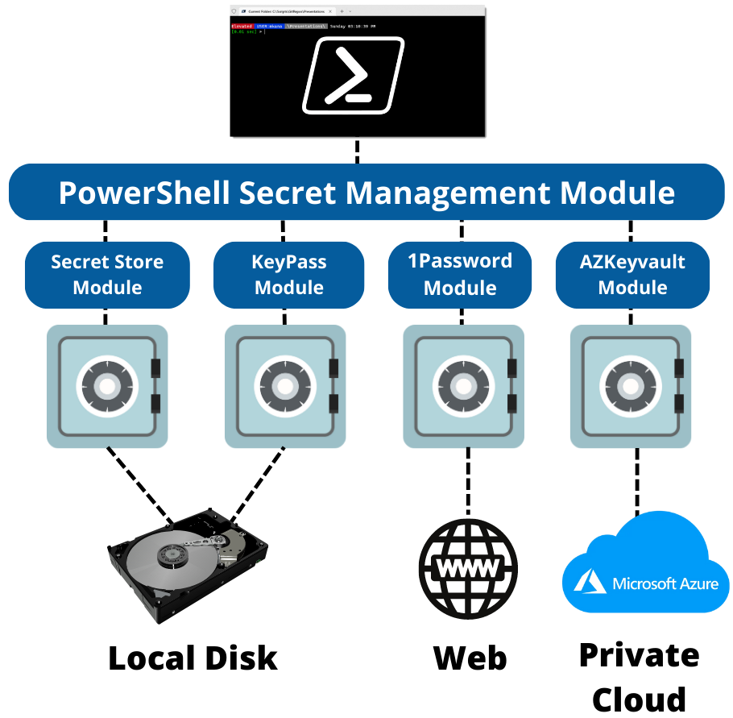
Secret Management Architecture

